Slide 1
near Titanium alloys
Priyanka Agrawal

Slide 2
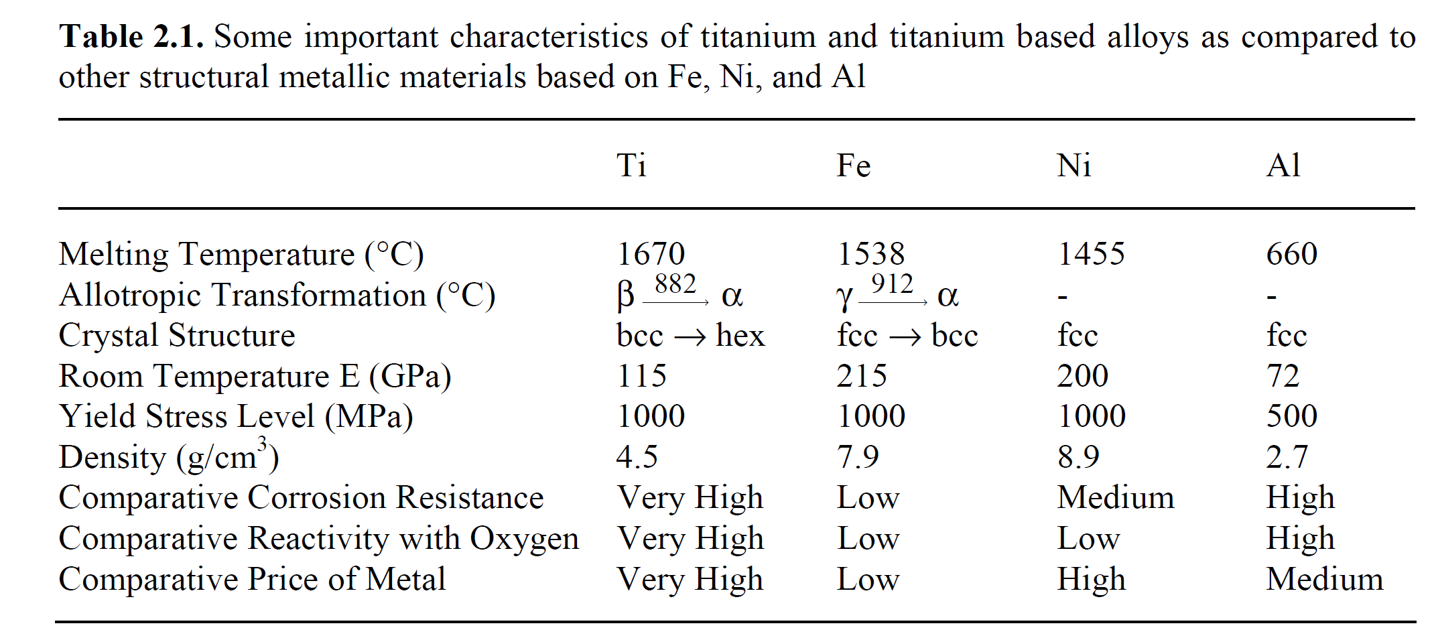
Basic properties
Ti alloy has high strength to weight ratio → used in important applications → high processing cost
Advantage over Al as a competitor in low density structural alloys – operating temperature 150 - 600 C.

Slide 3
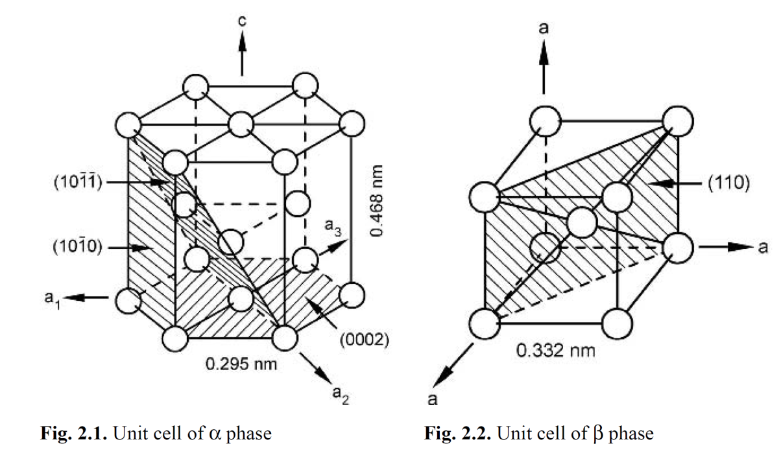
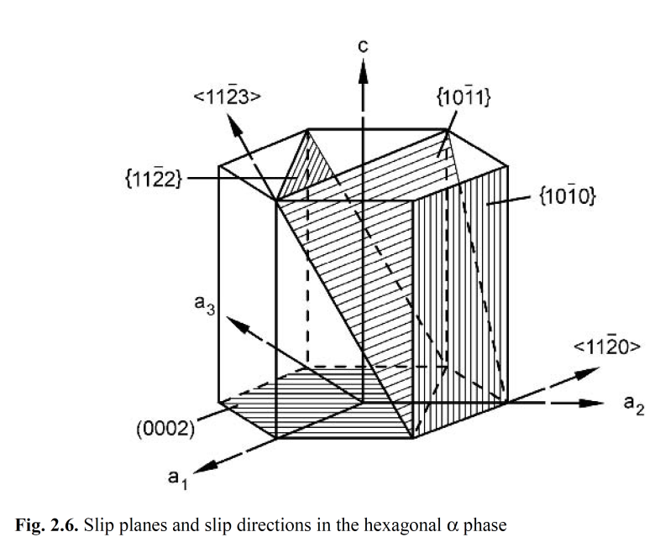
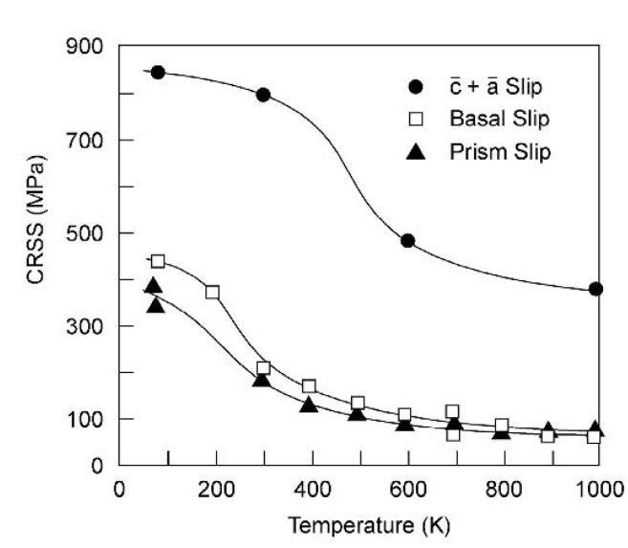
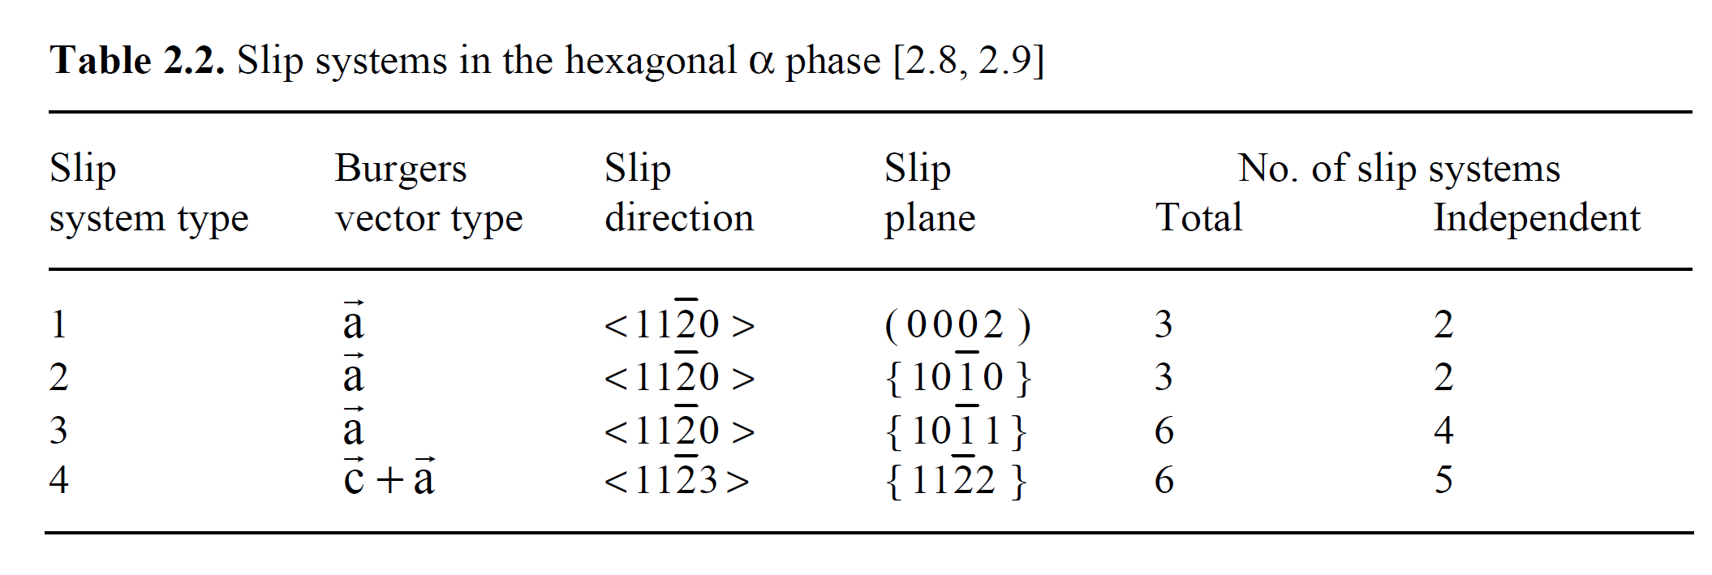
Crystal Structure and deformation mode

Slide 4
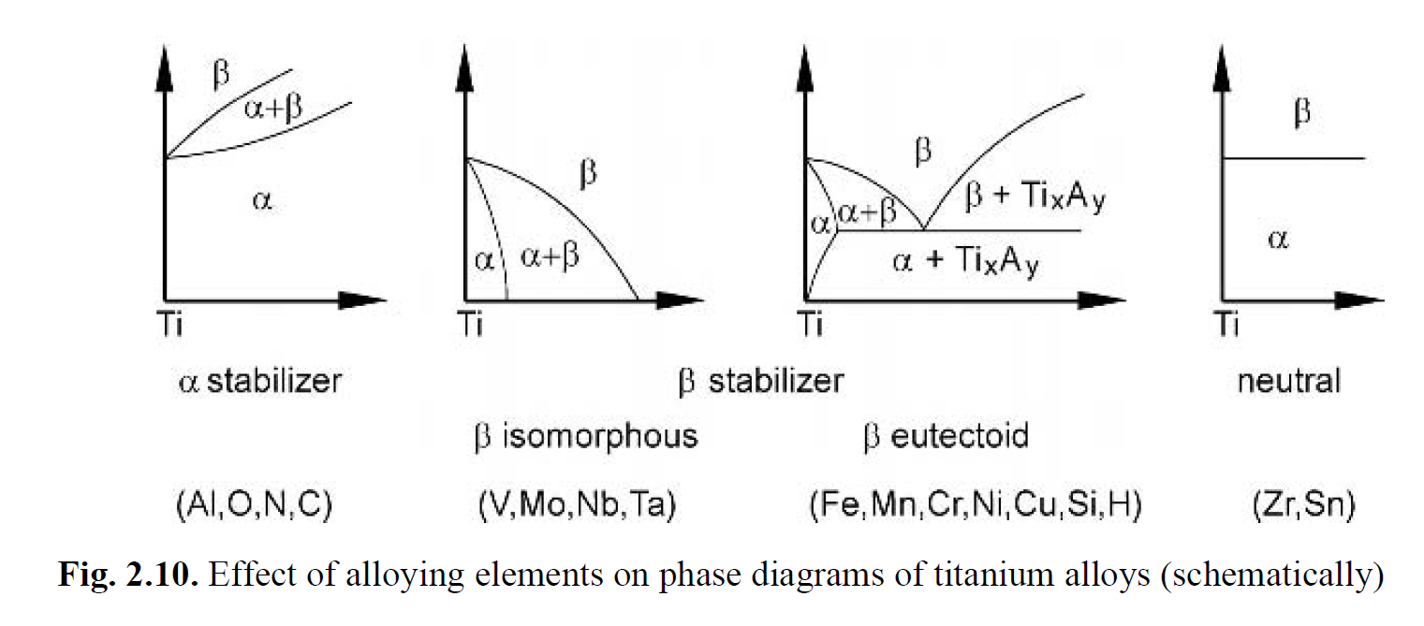
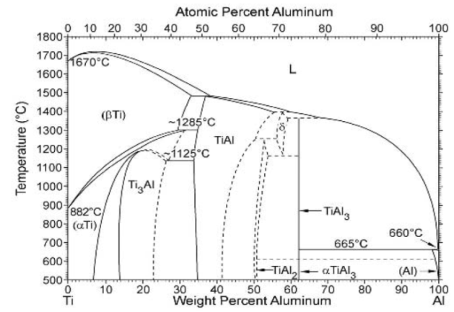
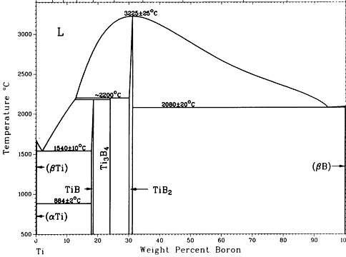
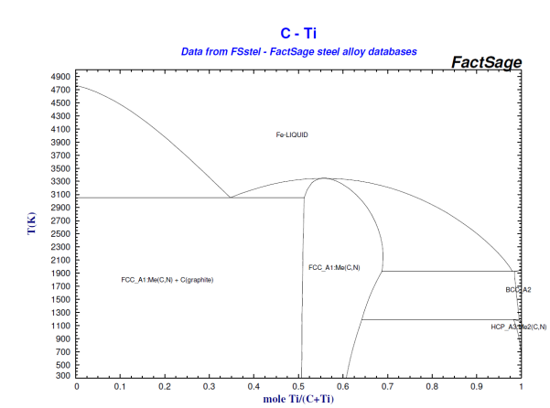
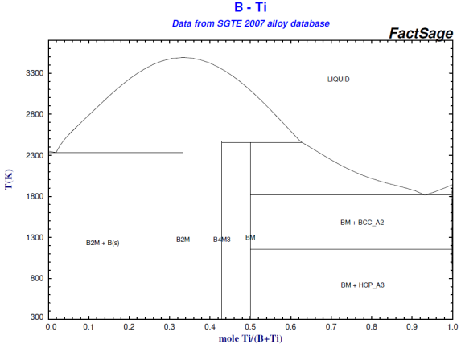
Phase diagrams
α stabilizers Al → increase the β transus, high solubility in α and β phases
O → interstitial → increases the strength

Slide 5
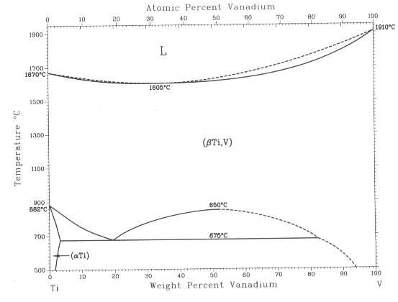
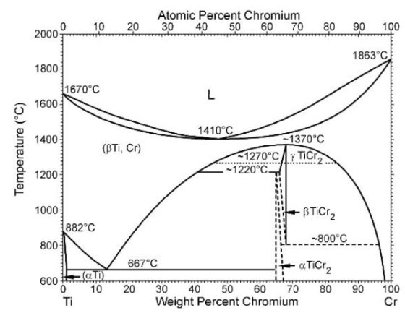
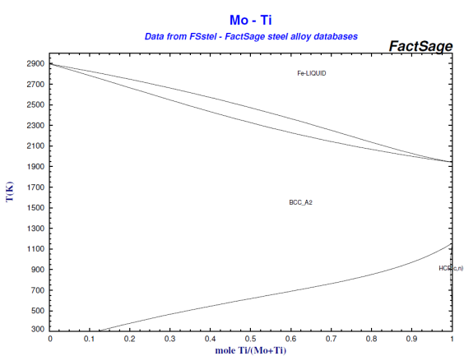
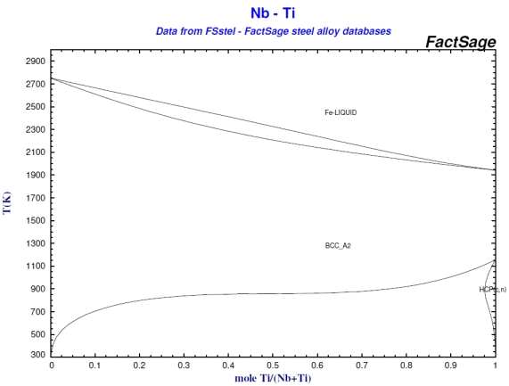
Phase diagrams
β stabilizers
a) isomorphous elements → V, Mo, Nb
Ta, Re
b) eutectoid forming elements → Cr, Fe, Si (Ni, Cu, Mn, W, Pd, Bi – limited usage)

Slide 6
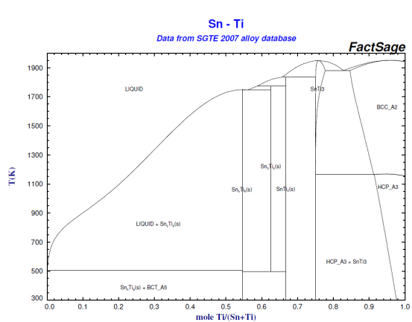
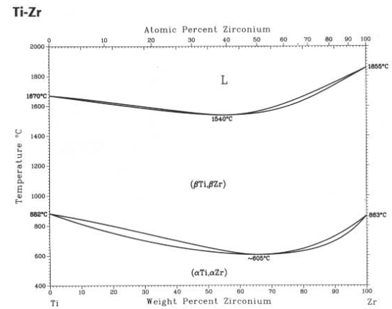
Phase diagrams
Neutral Zr, Hf, Sn
[Al]_{eq}= [Al] +0.17[Zr] + 0.33[Sn] + 10[O]

Slide 7
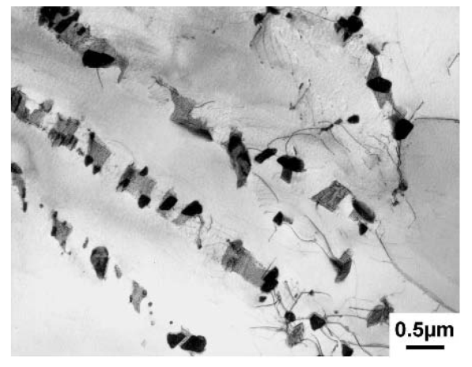
Physical metallurgy
Diffusion rates in β phase is about 2 orders of magnitude faster than α phase ⇒ reduce β vol%
Done by decreasing β stabilizers and increasing α stabilizers (AL, Sn and Zn)
V replaced by Nb and Mo as they are slower diffusing elements
Fe → strong β stabilizer leads to fast diffusion rates in α phase. So need to be reduced
Vol% β decreases → thickness of β lamellae reduced → α/α interface → easy slip for dislocations
Si added which forms intermetallic compound → incoherent silicide precipitates at the α/β boundaries and at the grain boundaries

Slide 8
Physical metallurgy
Diffusion rates in β phase is about 2 orders of magnitude faster than α phase ⇒ reduce β vol%
Done by decreasing β stabilizers and increasing α stabilizers (AL, Sn and Zn)
V replaced by Nb and Mo as they are slower diffusing elements
Fe → strong β stabilizer leads to fast diffusion rates in α phase. So need to be reduced
Vol% β decreases → thickness of β lamellae reduced → α/α interface → easy slip for dislocations
Si added which forms intermetallic compound → incoherent silicide precipitates at the α/β boundaries and at the grain boundaries
Coherent precipitates effective barriers → vol fraction of α₂ particles increases by Sn addition → aging treatment is given in (α + α₂) region

Slide 9
Near α Ti alloys
IMI 834 (Ti-5.8Al-4Sn-3.5Zr-0.5Mo-0.7Nb-0.35Si-0.06C)
IMI 685 (Ti-6Al-5Zr-0.5Mo-0.25Si)
IMI 829 (Ti-5.55Al-3.55Sn-3.16Zr-1Nb-0.25Mo-0.3Si)
Ti6242 (Ti-6Al-2Sn-4Zr-2Mo)
VT9 (Ti-6.5Al-1.5Zr-3Mo-0.25Si)
Ti 6242S used in both β treated and α+β treated condition (higher α vol fraction than IMI 834)
IMI 685 in β treated condition
β treatment → transformation temp is high – grain growth of β phase rapid in absence of any inhibiting factor
IMI 834 used in duplex α+β treated condition (primary α at grain boundaries which impedes the rapid β grain growth)
IMI834 contains small amount of C to flatten the β approach curve →desired small vol fraction of equiaxed α can be produced over a wider temperature range

Slide 10
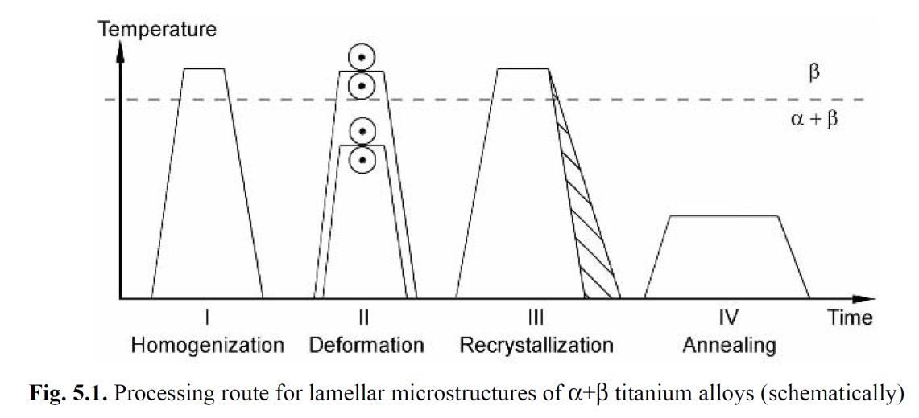
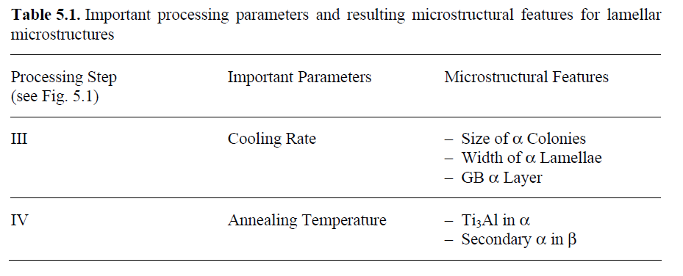
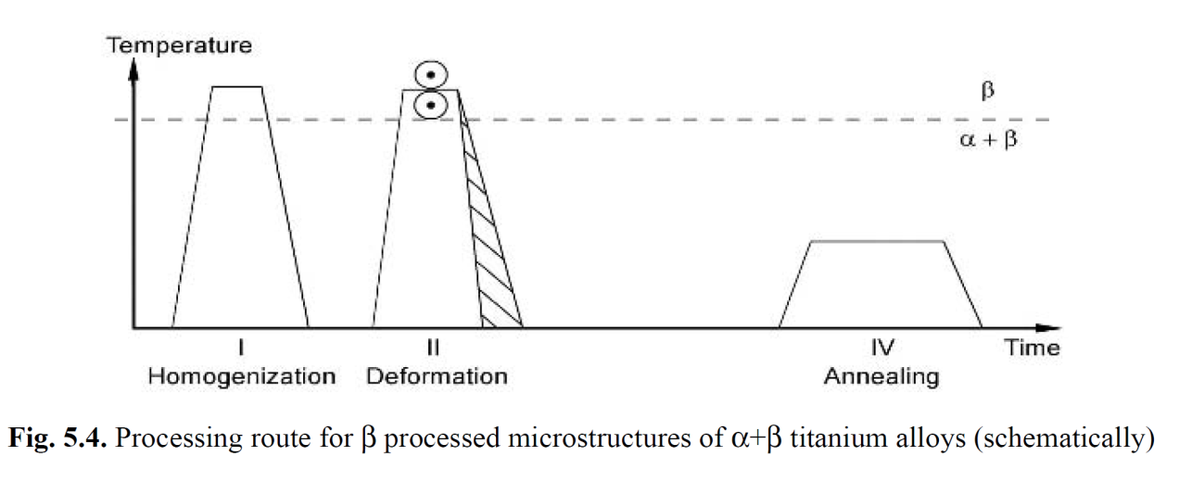
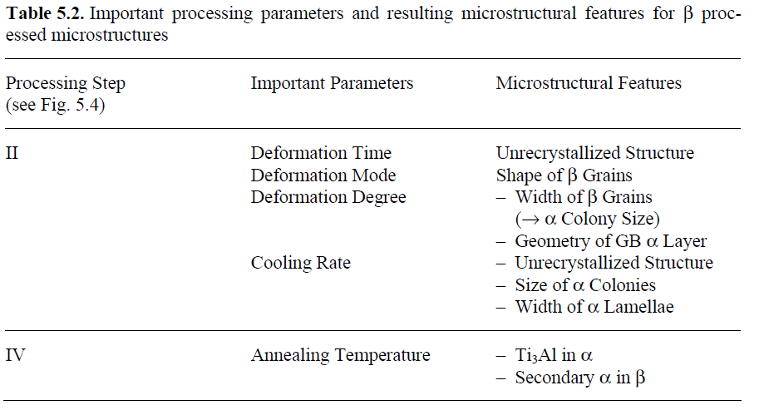
Effect of heat treatment on the microstructure

Slide 11
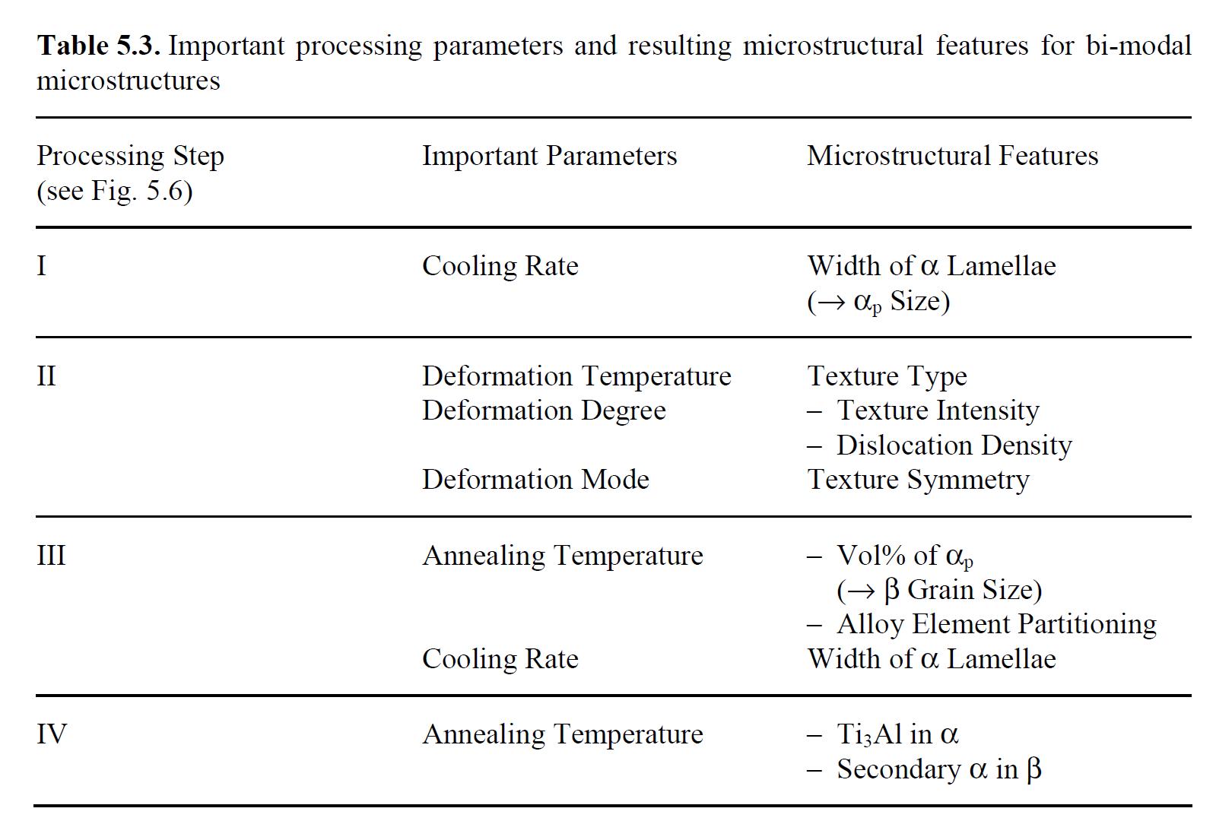
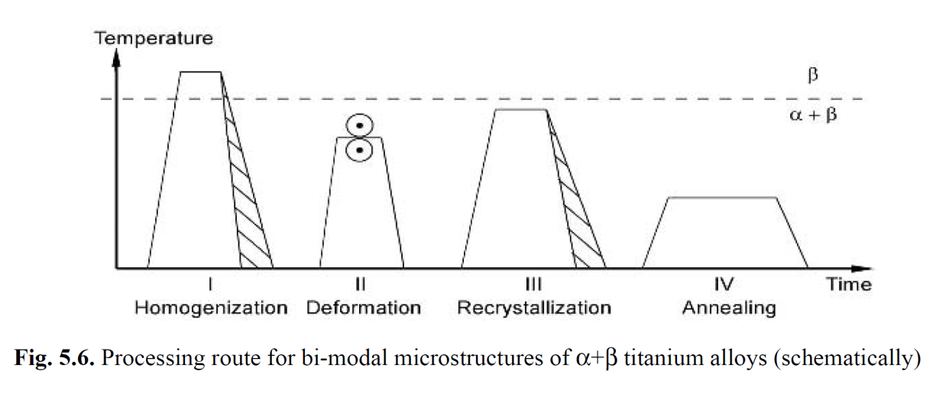
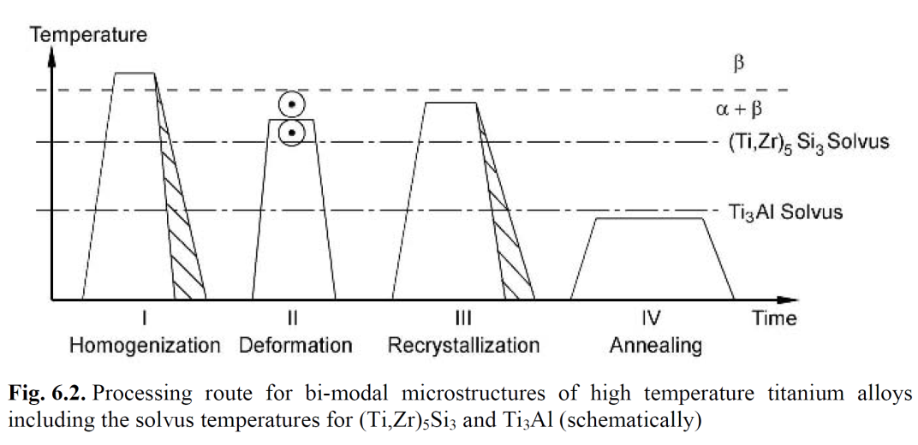
Effect of heat treatment on the microstructure

